Slide 1
Network Security
UNIT 1 INTRODUCTION
Services, Mechanisms and attacks - The OSI Security Architecture- A Model for Network Security – Classical Encryption Technique – Symmetric Cipher Model – Substitution Technique – Rotor Machines – Steganography

Slide 2
Introduction
The art of war teaches us to rely not on the likelihood of the enemy's not coming, but on our own readiness to receive him; not on the chance of his not attacking, but rather on the fact that we have made our position unassailable.
—The Art of War, Sun Tzu

Slide 3
Computer Security Concepts
Information Security requirements have changed in recent times
traditionally provided by physical and administrative mechanisms
computer use requires automated tools to protect files and other stored information
use of networks and communications links requires measures to protect data during transmission

Slide 4
Definitions
Computer Security - generic name for the collection of tools designed to protect data and to thwart hackers
Network Security - measures to protect data during their transmission
Internet Security - measures to protect data during their transmission over a collection of interconnected networks

Slide 5
Key objectives of computer security

Slide 6
THE CHALLENGES OF COMPUTER SECURITY
1. Security is not as simple as it might first appear to the novice. The requirements seem to be straightforward; indeed, most of the major requirements for security services can be given self- explanatory, one-word labels: confidentiality, authentication, non repudiation, or integrity
2. In developing a particular security mechanism or algorithm, one must always consider potential attacks on those security features.

Slide 7
THE CHALLENGES OF COMPUTER SECURITY
3. Typically, a security mechanism is complex, and it is not obvious from the statement of a particular requirement that such elaborate measures are needed.
4. Having designed various security mechanisms, it is necessary to decide where to use them. This is true both in terms of physical placement and in a logical sense
.
5. Security mechanisms typically involve more than a particular algorithm or protocol

Slide 8
LEGAL, ETHICAL AND PROFESSIONAL ASPECTS OF SECURITY
Cyber-Crime: - Criminal activities or attacks in which computer and computer networks are tool, target, or place of criminal activity. Cybercrime categorize based on computer roles such as target, storage device and communication tool.
Computers as targets: To get the information from the computer system or control the computer system without the authorization or payment or alter the interfaces or data in the particular system with use of server.

Slide 9
Illegal access: The access to the whole or any part of a computer system without right. Illegal interception: The interception without right, made by technical means, of non-public transmissions of computer data to, from or within a computer system, including electromagnetic emissions from a computer system carrying such computer data.
Data interference: The damaging, deletion, deterioration, alteration or suppression of computer data without right.
System interference: The serious hindering without right of the functioning of a computer system by inputting, transmitting, damaging, deleting, deteriorating, altering or suppressing computer data.
Computer-related forgery: The input, alteration, deletion, or suppression of computer data, resulting in inauthentic data with the intent that it be considered or acted upon for legal purposes as if it were authentic, regardless whether or not the data is directly readable and intelligible.
Crime related to child pornography: Producing child pornography or distribution through a computer system and making available or distributing or transmitting child pornography through a computer system.

Slide 10
Intellectual Properties
Patents: A patent for an invention is the grant of a property right to the inventor.
Trade-Marks: A trademark is a word, name, symbol or expression which used to identify the products or services in trade uniquely from others. Trade mark rights used to prevent others from using a confusingly similar mark, but not to prevent others from making the same goods or from selling the same goods or services under a clearly different mark.

Slide 11
Ethical issues related to computer and info systems
Computers have become the primary repository of both personal information and negotiable assets, such as bank records, securities records, and other financial information.
Repositories and processors of information: Unauthorized use of otherwise unused computer services or of information stored in computers raises questions of appropriateness or fairness.
Producers of new forms and types of assets: For example, computer programs are entirely new types of assets, possibly not subject to the same concepts of ownership as other assets.
Symbols of intimidation and deception: The images of computers as thinking machines, absolute truth producers, infallible, subject to blame, and as anthropomorphic replacements of humans who err should be carefully considered.

Slide 12
Security Policies
Role of the Security Policy in Setting up Protocols
Who should have access to the system?
How it should be configured?
How to communicate with third parties or systems?

Slide 13
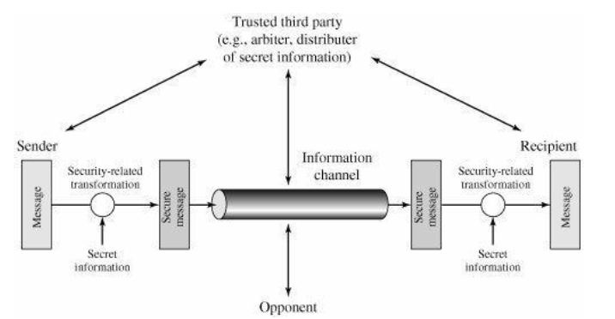
A MODEL FOR NETWORK SECURITY

Slide 14
1. Design an algorithm for performing the security-related transformation. The algorithm should be such that an opponent cannot defeat its purpose.
2. Generate the secret information to be used with the algorithm.
3. Develop methods for the distribution and sharing of the secret information.
4. Specify a protocol to be used by the two principals that makes use of the security algorithm and the secret information to achieve a particular security service

Slide 15
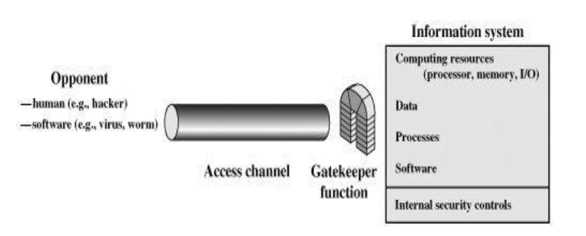
Network access Security model

Slide 16
OSI Security Structure /Mechanism
pervasive security mechanisms:
trusted functionality: functionality that can be trusted to perform as intended.
security labels: every item is associated with a security label. For example : a label for sensitivity level.
event detection : detective and could be corrective mechanism m for security event.
security audit trails: Review and Examination of system records and activities
security recovery : implementing corrective security mechanisms and putting them in appropriate place.

Slide 17
The OSI Security Architecture
In an organization, the manager responsible for security has to effectively assess the security needs of an organization.
He has to evaluate and choose various security products and policies.
Thus, the manager
needs some way of defining the for security and
the
systematic requirements characterizing
approaches to
satisfying those requirements.

Slide 18
The OSI Security Architecture
This is difficult enough in a centralized data processing environment.
With the use of local and wide area networks, the problems are compounded.
Such a systematic approach was defined by the International Telecommunication Union (ITU) Telecommunication Standardization Sector (ITU-T).

Slide 19
The OSI Security Architecture
(ITU-T) is a United Nations sponsored agency that develops standards, called Recommendations, relating to telecommunications and to open systems interconnection (OSI).
Recommendation X.800, Security Architecture for OSI.
The open systems interconnection (OSI) security architecture was developed in the context of the OSI protocol architecture.

Slide 20
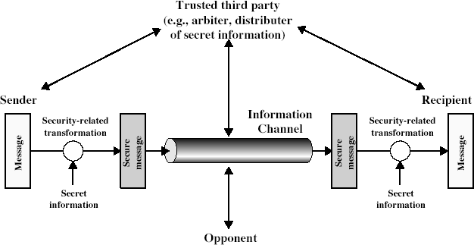
Model for Network Security

Slide 21
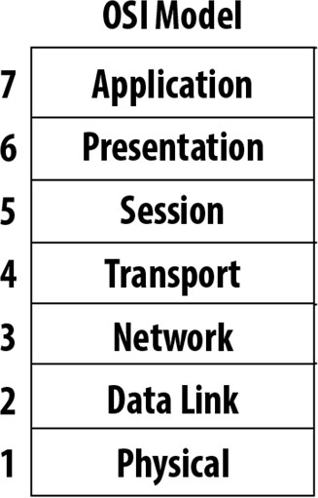
The OSI Security Architecture
OSI
protocol
architecture
11

Slide 22
The OSI Security Architecture
The OSI security architecture is useful to managers as a way of organizing the task of providing security.
It focuses on security attacks, mechanisms, and services.
These are defined next:
12

Slide 23
Services, Mechanisms, Attacks
need systematic way to define requirements
consider three aspects of information security:
security attack
security mechanism
security service
consider in reverse order

Slide 24
Threat
A potential for violation of security, which exists when there is a circumstance, capability, action, or event that could breach security and cause harm. That is, a threat is a possible danger that might exploit a vulnerability.

Slide 25
Attack
An assault on system security that derives from an intelligent threat; that is, an intelligent act that is a deliberate attempt (especially in the sense of a method or technique) to evade security services and violate the security policy of a system.

Slide 26
Security Attack
any action that compromises the security of information owned by an organization
information security is about how to prevent attacks, or failing that, to detect attacks on information-based systems
have a wide range of attacks
can focus of generic types of attacks
note: often threat & attack mean same

Slide 27
Passive Attacks
Release of message contents
Traffic analysis

Slide 28
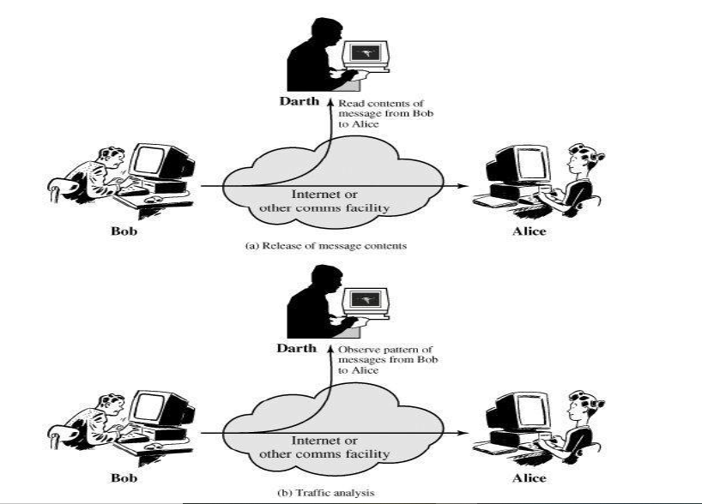

Slide 29
Active Attacks
Active attacks involve some modification of the data stream or the creation of a false stream and can be subdivided into four categories: masquerade, replay, modification of messages, and denial of service.

Slide 30
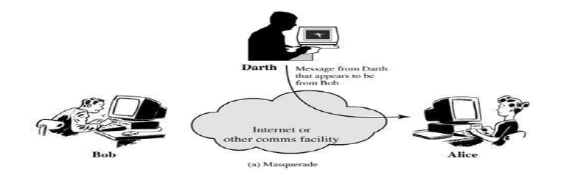
Masquerade

Slide 31
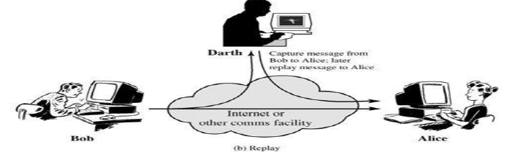
Replay

Slide 32
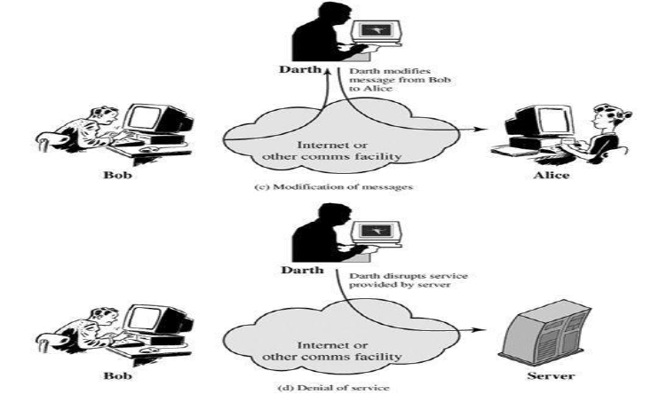
Modification of message and Denial of Service

Slide 33
Security Service
is something that enhances the security of the data processing systems and the information transfers of an organization
intended to counter security attacks
make use of one or more security mechanisms to provide the service
replicate functions normally associated with physical documents
eg. have signatures, dates; need protection from disclosure, tampering, or destruction; be notarized or witnessed; be recorded or licensed

Slide 35
Security Mechanism
a mechanism that is designed to detect, prevent, or recover from a security attack
no single mechanism that will support all functions required
however one particular element underlies many of the security mechanisms in use: cryptographic techniques
hence our focus on this area

Slide 37
Classical Encryption Technique

Slide 38
Block Ciphers and the Data Encryption Standard
All the afternoon Mungo had been working on Stern's code, principally with the aid of the latest messages which he had copied down at the Nevin Square drop. Stern was very confident.
He must be well aware London Central knew
about that drop. It was obvious that they didn't care how often Mungo read their messages, so confident were they in the impenetrability of the code.
—Talking to Strange Men, Ruth Rendell

Slide 39
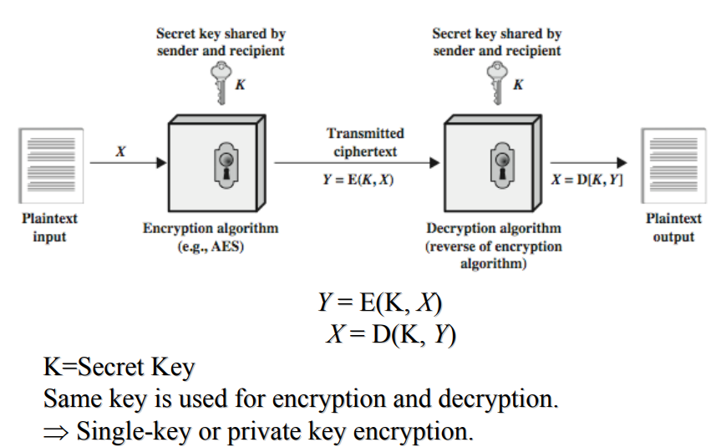
Symmetric Cipher Model

Slide 40
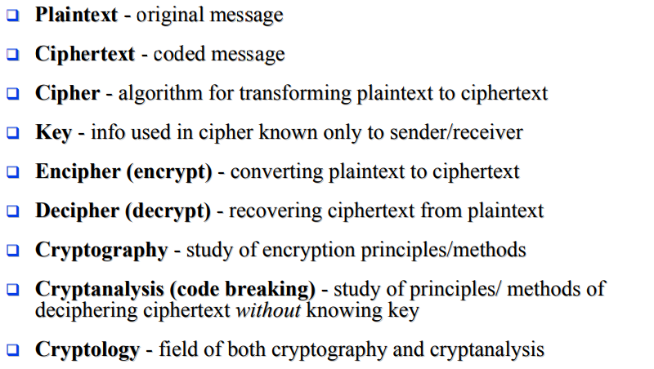

Slide 41
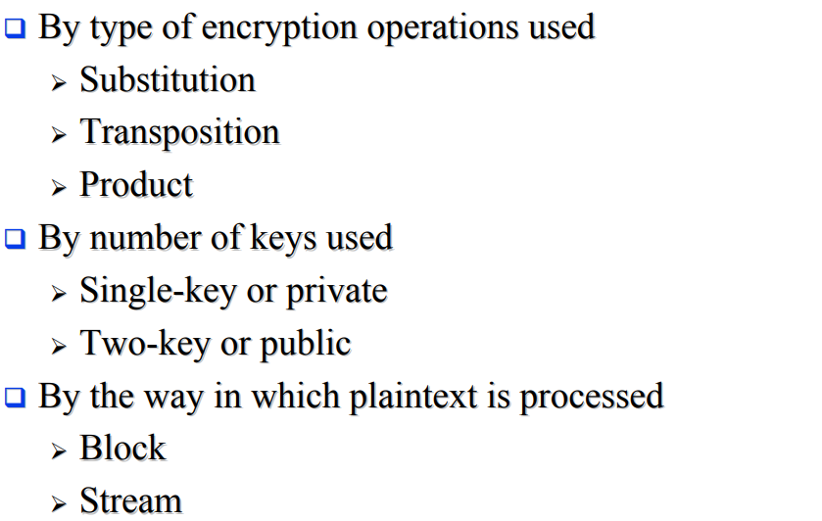

Slide 43
Block vs Stream Ciphers
block ciphers process messages in into blocks, each of which is then en/decrypted
like a substitution on very big characters
– 64-bits or more
stream ciphers process messages a bit or byte at a time when en/decrypting
many current ciphers are block ciphers
hence are focus of course

Slide 44
The OSI Security Architecture (brainkart.com)

Slide 45
Chapter 2: Classical Encryption Techniques
1

Slide 46
Classical Encryption Techniques
What is Encryption?
Encryption, is the process of changing information in such a way as to make it unreadable by anyone except those possessing special knowledge (usually referred to as a "key") that allows them to change the information back to its original, readable form.
Goals of this chapter:
Introduce basic concepts and classical terminologies and encryption technologies.
An introduction to the upcoming chapters.

Slide 47
Classical Encryption Techniques
Basic Terminology and Key words:
Plaintext: Refers to the original text or message to be encrypted.
Ciphertext: The encrypted message.
Enciphering or Encryption: The process of converting plaintext into a ciphertext.
Deciphering or Decryption: The process of decoding the ciphertext and retrieving the original plain
text.
Encryption algorithms: a pseudocode based on mathematical equations to perform encryption. Usually requires two inputs; the Plaintext and the Secret Key.
Decryption algorithm: Used to perform the decryption. Usually requires two inputs as well;
Ciphertext and Secret Key.
Secret Key: A special key used for encryption and decryption, known as well as Symmetric Key.

Slide 48
Classical Encryption Techniques
Basic Terminology and Key words:
Cipher or Cryptographic system: Refers to the scheme used for encryption and decryption.
Cryptography: The science that studies and analyze ciphers.
Cryptanalysis: Science of studying attacks against cryptographic systems.
Cryptology: The science that merge both Cryptography and Cryptanalysis.
Symmetric Cipher: Using the same key for encryption and decryption such as:
Block Cipher: Encrypts a block of plaintext at a time ( usually 64 or 128 bits).
Asymmetric Cipher: Using different keys for encryption and decryption phases.

Slide 49
Classical Encryption Techniques
1. Symmetric Cipher model:
The symmetric encryption technique uses the same key to encrypted and decrypt the plaintext.
The symmetric cypher model consist of five elements:
Plaintext.
Encryption algorithm.
Secret Key.
Ciphertext.
Decryption algorithm.
The security level of the symmetric encryption depends on the secrecy of the key, and NOT the secrecy of the algorithm.

Slide 50
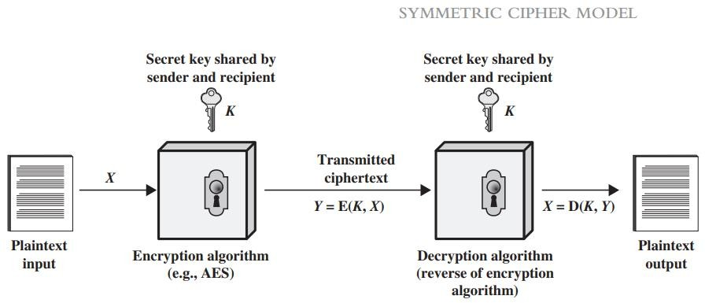
Classical Encryption Techniques
1. Symmetric Cipher model:
Plaintext is the original message or data that will be fed to the encryption algorithm as an input.
Encryption algorithm performs various substitutions and transformations on the plaintext.
Secret key is a value independent of the plaintext and of the algorithm. The exact substitutions and transformations performed by the algorithm depend on the key.

Slide 51
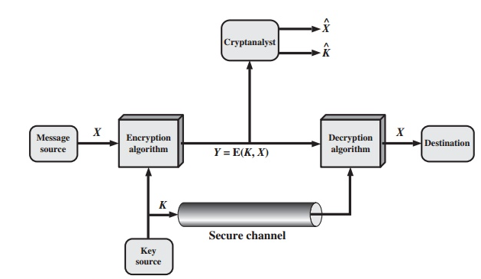
Classical Encryption Techniques
1. Symmetric Cipher model:
Ciphertext is the unreadable message produced as output. It depends on the plain text and the
secret key.
Decryption algorithm takes the cipher text and the secret key to retrieve the original text

Slide 52

Classical Encryption Techniques
1. Symmetric Cipher model: Mathematical representation
Mathematically, the equation related to the encryption algorithm can be represented as follows
Y = E(K, X)
Where Y = cipher text, E = encryption, K = Secret shared key, X = Plaintext
The equation related to the decryption can as well be represented as follows:
D = E(K, X)
Where D = Decryption
Some examples of symmetric encryption includes Data Encryption Standard (DES), Advanced Encryption Standard (AES), and BLOWFISH

Slide 53
Cryptanalysis and Brute-Force Attack
Cryptanalytic attacks rely on the nature of the algorithm plus perhaps some knowledge of the general characteristics of the plaintext or even some sample plaintext–ciphertext pairs. This type of attack exploits the characteristics of the algorithm to attempt to deduce a specific plaintext or to deduce the key being used.
Brute-force attack: The attacker tries every possible key on a piece of ciphertext until an intelligible translation into plaintext is obtained. On average, half of all possible keys must be tried to achieve success. If either type of attack succeeds in deducing the key, the effect is catastrophic: All future and past messages encrypted with that key are compromised

Slide 54
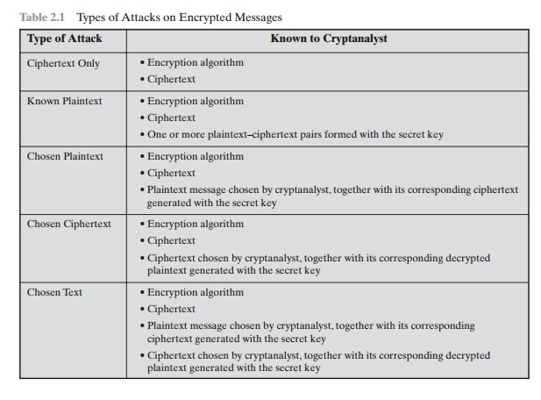

Slide 55
Classical Encryption Techniques
1. Symmetric Cipher model: Advantages and disadvantages
Advantage:
Symmetric key is faster than asymmetric key cryptography.
Same key is used for encryption and decryption, receiver cannot decrypt data without key ( shared by the sender)
Symmetric key achieves the authentication principle because it checks receiver’s identity.
System resources are less utilized.
Disadvantage:
Once key is diffused, transmitted data is not secure anymore and can easily be cracked.
In symmetric key cryptography, key MUST be shared first between sender and receiver and then message is transferred.

Slide 56
Classical Encryption Techniques
Substitution technique
Substitution technique is a classical encryption technique where the characters present in the original message are replaced by other characters or numbers or symbols. If the plain text (original message) is considered as the string of bits, then the substitution technique would replace bit pattern of plain text with the bit pattern of cipher text. The substitution techniques can be explained as follows:
Caesar Cipher.
Monoalphabetic Cipher.
Polyalphabetic Cipher.
Playfair Cipher.
One-Time Pad.
Hill Cipher.

Slide 57
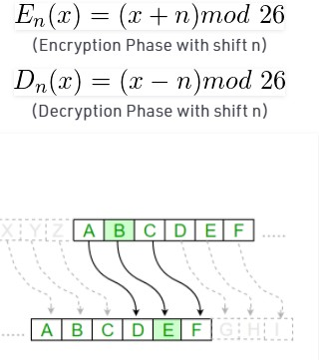
Classical Encryption Techniques
2. Substitution technique: Caesar Cipher
The Caesar Cipher technique is one of the earliest and simplest method of encryption technique. each letter of a given text is replaced by a letter some fixed number of positions down the alphabet. For example with a shift of 1, A would be replaced by B, B would become C, and so on.
The method is apparently named after Julius Caesar, who apparently
used it to communicate with his officials.
The encryption can be represented using modular arithmetic by first transforming the letters into numbers, according to the scheme, A = 0, B = 1,…, Z = 25. Encryption of a letter by a shift n can be described mathematically as the figure bellow.

Slide 58
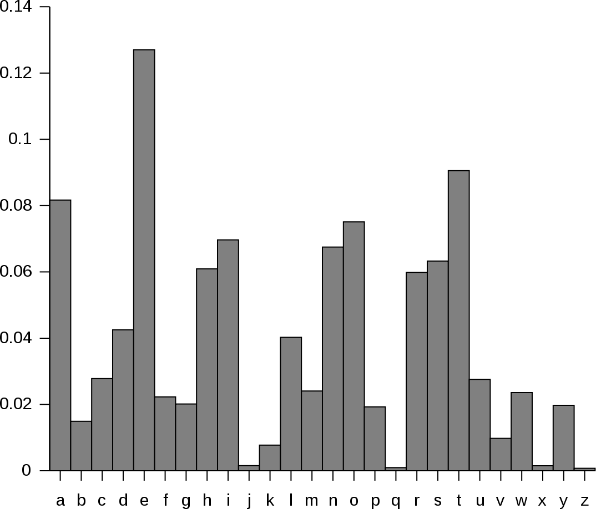

Classical Encryption Techniques
2. Substitution technique: Caesar Cipher
The weakness of this model was published 800 years later by an Arab Mathematician named Al-Kindi. Al- Kindi was capable of breaking the Caesar Cipher by using a clue based on a shared property of the language used in the message, which is the Frequency.
3

Slide 59
Classical Encryption Techniques
2. Substitution technique: Monoalphabetic Cipher
Monoalphabetic cipher is a substitution cipher in which for a given key, the cipher alphabet for each plain alphabet is fixed throughout the encryption process. For example, if ‘A’ is encrypted as ‘D’, for any number of occurrence in that plaintext, ‘A’ will always get encrypted to ‘D’.
The number of possible shifts is 26!, making it much more complicated than Caesar Cipher to break.

Slide 60


Classical Encryption Techniques
2. Substitution technique: Polyalphabetic Cipher
A strong cipher is one which disguises your fingerprint.
By the mid 15th century, cryptography has advanced to Polyalphabetic Cipher.
Message to Send:
Hide the money
Original Position: H i d e t h e m
o n e y
7 8 3 4 19 7 4 12 14 13 4 24
Secret Word: RICH
Letter Position: 17 – 8 – 2 – 7
17 8 2 7 17 8 2 7 17 8 2 7
YQFL KPG TFCGF
Ciphertext:
Adding Sequence: Hide the money
17 – 8 – 2 – 7 17 – 8 – 2 7 – 17 – 8 – 2 – 7

Slide 61
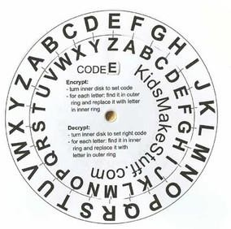
Classical Encryption Techniques
2. Substitution technique: Polyalphabetic Cipher: The Cipher Disc
The development of Polyalphabetic Substitution Ciphers was the cryptographers
answer to Frequency Analysis.
The first known polyalphabetic cipher was the Alberti Cipher invented by Leon Battista Alberti in around 1467. He used a mixed alphabet to encrypt the plaintext, but at random points he would change to a different mixed alphabet, indicating the change with an uppercase letter in the ciphertext.
In order to utilize this cipher, Alberti used a cipher disc to show how plaintext letters are related to ciphertext letters.

Slide 62
Classical Encryption Techniques
2. Substitution technique: Polyalphabetic Cipher
As an example we shall encrypt the plaintext "leon battista alberti". To keep with the convention of writing ciphertext in uppercase, we shall invert Alberti's own rule, and use lowercase letters to signify the change.
We start by referencing the starting position of the cipher disc, which in this case is "a" is encrypted as "V", so we start the ciphertext with a lowercase "v". We then encrypt the first few letters as a Caesar Shift, using the ciphertext alphabet given below.
Plaintext: Ciphertext:
leonbat vGZJIWVOg...

Slide 63
Classical Encryption Techniques
2. Substitution technique: Polyalphabetic Cipher
The uppercase letters above encrypt the plaintext letters given. The "v" indicates the starting position of the disc, and the "g" indicates that we need to change the position so that "G" is beneath "a". We then get the new ciphertext alphabet.
Plaintext: ...tistaa...
Ciphertext: ...gZOYZGGm
The encryption keep going this way until finishing the plain text

Slide 64
Classical Encryption Techniques
2. Substitution technique: Polyalphabetic Cipher
Due to the polyalphabetic nature of the Alberti Cipher (that is, the same plaintext letter is not always encrypted to the same ciphertext letter), it was a very secure cipher when it was invented.
Another early example of a polyalphabetic cipher was invented by Johannes Trithemius in the 15th Century. Rather than switching alphabets randomly, and indicating it with an uppercase letter, the Trithemius Cipher has the sender change the ciphertext alphabet after each letter was encrypted. This was the first example of a progressive
key cipher,
and he used a tabula recta to show all the different
alphabets.

Slide 65
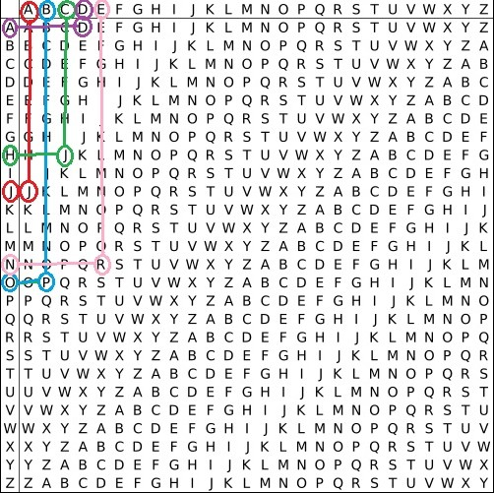
Classical Encryption Techniques
2. Substitution technique: Polyalphabetic Cipher
Trithemius' idea was to start at the column headed by "A", find the plaintext letter down the far left column, and encrypt this to the ciphertext letter in the first column. You would then move to the next column, and so on.
For example, the plaintext "johannes trithemius" would be encrypted as follows. The "j" would be found down the left column, and mapped to the letter in the column headed by A (shown in red). This gives "J". The "o" is found down the left
column, column, (shown
and traced to the ciphertext in the B which is "P" (shown in blue). The "h"
in green) gives "J", the "a" (shown
in purple) gives "D", and the "n" (shown in pink) gives "R". Continuing in this way we get
"JPJDRSKZ BASETRAXKJ".
20

Slide 66
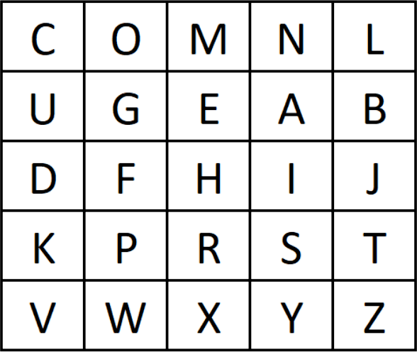
Classical Encryption Techniques
2. Substitution technique: Playfair Cipher
It was the first practical substitution digraph. The scheme was invented in 1854 by Charles Wheatstone but was named after Lord Playfair who promoted the use of the cipher. In Playfair, cipher unlike traditional cipher we encrypt a pair of alphabets (digraphs) instead of a single alphabet.
It was used for tactical purposes by British forces in the Second Boer War and in World War I and for the same purpose by the Australians during World War II. This was because Playfair is reasonably fast to use and requires no special equipment.

Slide 67
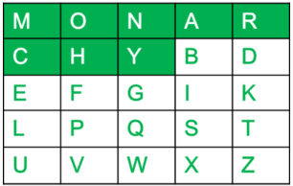
Classical Encryption Techniques
2. Substitution technique: Playfair Cipher
Encryption Techniques:
We can follow 2 main steps with 3 rules to encrypt a plaintext using the
Playfair Cipher.
First, we need to set a key; Exp: monarchy
Lets the word “instruments” be our plain text to encrypt.
Generate the key Square(5×5):The key square is a 5×5 grid of alphabets that acts as the key for encrypting the plaintext. Each of the 25 alphabets must be unique and one letter of the alphabet (usually J) is omitted from the table (as the table can hold only 25 alphabets). If the plaintext contains J, then it is replaced by I.
The initial alphabets in the key square are the unique alphabets of the key in the order in which they appear followed by the remaining letters of the alphabet in order.

Slide 68
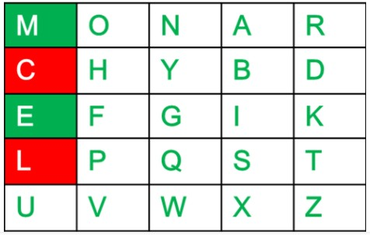
Classical Encryption Techniques
2. Substitution technique: Playfair Cipher
Algorithm to encrypt the plain text: The plaintext is split into pairs of two letters (digraphs). If there is an odd number of letters, a Z is added to the last letter.
For example:
PlainText: "instruments"
After Split: 'in' 'st' 'ru' 'me' 'nt' 'sz'
Rules for Encryption: If both the letters are in the same column: Take the letter below each one (going back to the top if at the bottom).
For example:
Diagraph: "me" Encrypted Text: cl Encryption: m -> c
e -> l

Slide 69
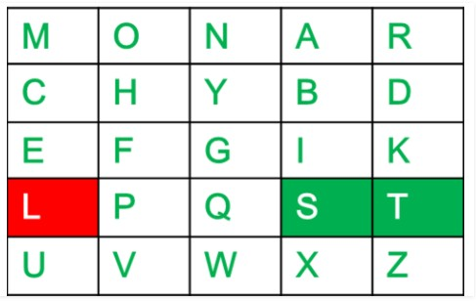
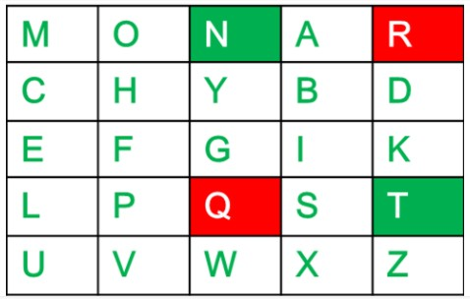
Classical Encryption Techniques
2. Substitution technique: Playfair Cipher
If both the letters are in the same row: Take the letter to the right of each one (going back to the leftmost if at the rightmost position).
For example:
Diagraph: "st"
Encrypted Text: tl
Encryption: s -> t t -> l
If neither of the above rules is true: Form a rectangle with the two letters and take the letters on the horizontal opposite corner of the rectangle.
For example:
Diagraph: "nt"
Encrypted Text: rq
Encryption: n -> r t -> q

Slide 70
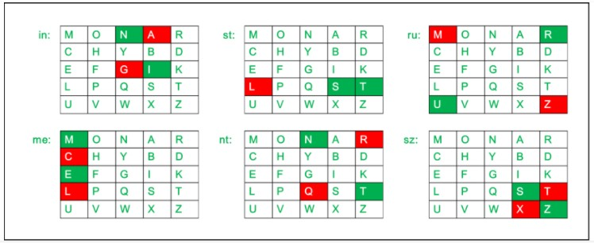
Classical Encryption Techniques
2. Substitution technique: Playfair Cipher
Plain Text: "instrumentsz" Encrypted Text: gatlmzclrqtx Encryption:
i | -> | g
n | -> | a
s | -> | t
t | -> | l
r | -> | m
u | -> | z
m | -> | c
e | -> | l
n | -> | r
t | -> | q
s | -> | t
z | -> | x

Slide 71
Classical Encryption Techniques
2. Substitution technique: One-Time Pad
In cryptography, a one-time pad is a system in which a private key generated randomly is used only once to encrypt a message that is then decrypted by the receiver using a matching one-time pad and key.
Messages encrypted with keys based on randomness have the advantage that there is theoretically no way to "break the code" by analyzing a succession of messages.
Each encryption is unique and bears no relation to the next encryption so that some pattern can be detected. With a one-time pad.

Slide 72
Classical Encryption Techniques
2. Substitution technique: One-Time Pad
How it works?
Convert the plaintext to binary.
Generate a key that is totally random. And, in binary, is at least as long as the plaintext or longer.
Produce the ciphertext by applying bitwise XOR on the plaintext and the key.
Example:
Plaintext: Hi!
Key: 0I;@
Ciphertext
1001000 1101001 0100001
XOR
0110000 1101100 0111011 1000000
1111000 0000101 0011010 1000000

Slide 73
Classical Encryption Techniques
2. Substitution technique: Hill Cipher
Hill cipher is a polygraphic substitution cipher based on linear algebra. Each letter is represented by a number modulo 26.
Often the simple scheme A = 0, B = 1, …, Z = 25 is used, but this is not an essential feature of the cipher.
To encrypt a message, each block of n letters is multiplied by an invertible n × n matrix, against modulus 26.
To decrypt the message, each block is multiplied by the inverse of the matrix used for encryption.
The matrix used for encryption is the cipher key, and it should be chosen randomly from the set of
invertible n × n matrices (modulo 26)

Slide 74
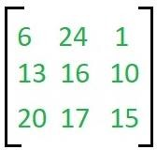

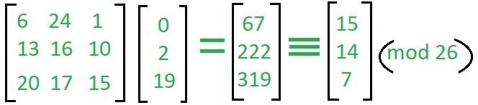
Classical Encryption Techniques
2. Substitution technique: Hill Cipher: Example
Input : Plaintext: ACT Key: GYBNQKURP
Output : Ciphertext: POH
We have to encrypt the message ‘ACT’ (n=3).The key is ‘GYBNQKURP’ which can be written as the nxn matrix:
The message ‘ACT’ is written as vector:
The enciphered vector is given as:
which corresponds to ciphertext of ‘POH’

Slide 75
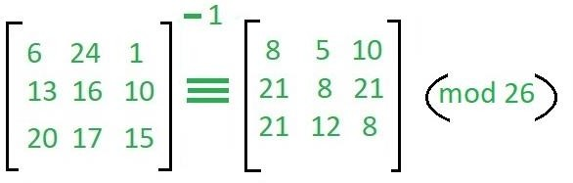
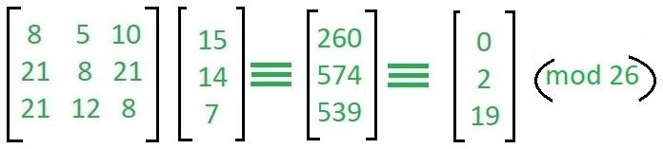
Classical Encryption Techniques
2. Substitution technique: Hill Cipher: Example
To decrypt the message, we turn the ciphertext back into a vector, then simply multiply by the inverse matrix of the key matrix .The inverse of the matrix used in the previous example is:
For the previous Ciphertext ‘POH’:
which gives us back ‘ACT’.

Slide 76

Classical Encryption Techniques
3. Transposition Cipher
Transposition Cipher is a cryptographic algorithm where the order of alphabets in the plaintext is rearranged to form a cipher text. In this process, the actual plain text alphabets are not included.
A simple example for a transposition cipher is columnar transposition cipher where each character in the plain text is written horizontally with specified alphabet width. The cipher is written vertically, which creates an entirely different cipher text.
Consider the plain text hello world, and let us apply the simple columnar transposition
technique.
The plain text characters are placed horizontally and the cipher text is created with vertical format as : holewdlo lr. Now, the receiver has to use the same table to decrypt the cipher text to plain text.

Slide 77
Classical Encryption Techniques
3. Transposition Cipher: Book Cipher or Running Key Cipher
The book cipher or the running key cipher works on the basic principle of one-time pad cipher. In onetime pad cipher the key is taken as long as the plain text and is discarded after the use. Every time a new key is taken for a new message.
The improvement to the onetime pad in Book cipher is that the key or the onetime pad is taken from the book. Let
us discuss the steps:
Step 1: Convert the plain text in numeric form consider A=0, B=1, C=3 …, Z=25.
Step 2: Take a onetime pad or key from any of the books and convert it in the numeric form also. But the key must be as long as the length of plain text.
Step 3: Now add the numeric form of both plain text and key, each plain text letter with corresponding key text letter. If the addition of any plain text letter with corresponding key text letter is >26, then subtract it with 26.

Slide 78
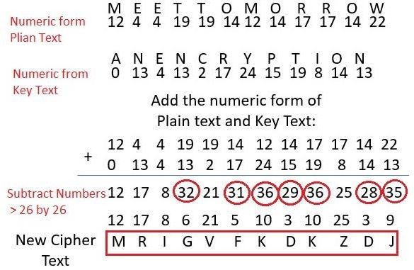
Classical Encryption Techniques
3. Transposition Cipher: Book Cipher or Running Key Cipher: Example
Let us understand with the example:
Plain text: Meet Tomorrow
Key taken from the book: ANENCRYPTION.
Now we have to convert this plain text and key text in numeric form and add them to get cipher text as shown in
the below:

Slide 79
Classical Encryption Techniques
3. Product Cipher
Product cipher, data encryption scheme in which the ciphertext produced by encrypting a plaintext document is subjected to further encryption. By combining two or more simple transposition ciphers or substitution ciphers, a more secure encryption may result.
One of the most famous field ciphers of all time was a fractionation system, the ADFGVX cipher employed by the German army during World War I. This system used a 6 × 6 matrix to substitution-encrypt the 26 letters and 10 digits into pairs of the symbols A, D, F, G, V, and X. The resulting biliteral cipher was then written into a rectangular array and route encrypted by reading the columns in the order indicated by a key word.
The great French cryptanalyst Georges J. Painvin succeeded in cryptanalyzing critical ADFGVX ciphers in 1918, with devastating effect for the German army in the battle for Paris.

Slide 80
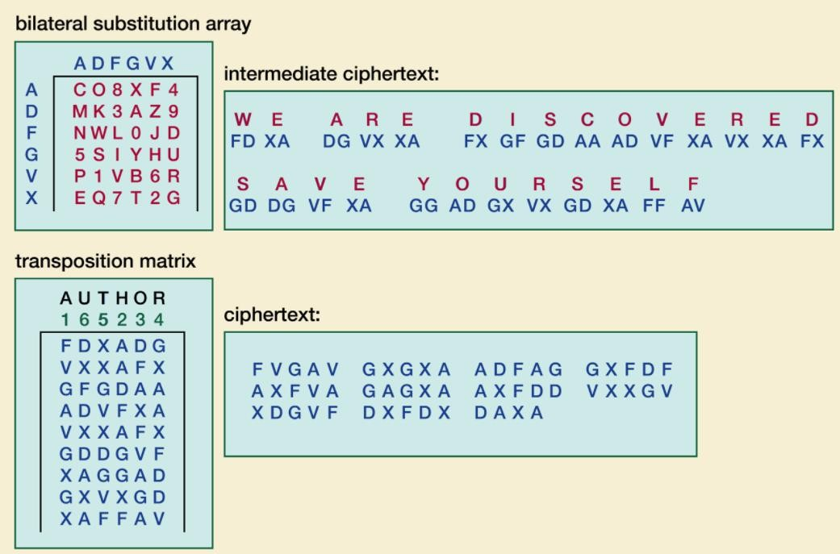
Classical Encryption Techniques
3. Product Cipher: Example

Slide 81
Symmetric Cipher Model (brainkart.com)

Slide 82
Unit-1
Rotor Machine, Steganography

Slide 83
Electric rotor machines were mechanical devices that allowed to use encryption algorithms that were much more complex than ciphers, which were used manually.

Slide 84
Advantage
The concept of using rotor machines in cryptography occurred to a number of inventors independently. At present, two Dutch naval officers, Theo A. van Hengel (1875 – 1939) and R. P. C. Spengler (1875 – 1955) are considered to invent the first rotor cipher machine in 1915. There were four more people who created (more or less independently) their own cryptographic rotor machines not much time later: Edward Hebern, Arvid Damm, Hugo Koch and Arthur Scherbius.
Electro-mechanical machines fitted with movable rotors were able to produce long random keystreams, thus allowing to encrypt messages by using complicated polyalphabetic substitution ciphers.

Slide 85
The main idea that lies behind rotor machines is relatively simple. One can imagine a simple device, similar to a typewriter, with a number of keys used to input text. The number of keys may differ, however usually there are 26 to 32 characters.

Slide 86
Simple substitution cipher
Each keystroke produces an output character, depending of the internal construction of the machine. In the simplest case, if only wires are used (without any rotors), each input key will be mapped to one specific output character.
For example, if someone pressed K in the keyboard, the machine would always produce C.
As a result, the machine would encrypt the messages by using a simple substitution cipher.

Slide 87
Adding a rotor
Having a simple substitution machine, one can imagine adding an additional internal rotor with an internal wiring. The rotor will rotate with a gear, each time after a keystroke. As a result, after pressing the same letter twice, it will be encoded differently due to different internal wiring.
For example, if someone pressed KK in the keyboard, the machine would produce CB (because the wiring changed after the first keystroke, due to the rotor movement).
The internal wiring of the rotor should be kept secret, however we may expect that over time the enemy will discover its design. It will make it easier for them to break the cipher but it won't compromise the security altogether.
To decode a ciphertext the receiver would need a machine with the same rotor. Adding the rotor caused the encryption to become a stronger polyalphabetic substitution cipher.

Slide 88
To improve the security, one could add more rotors. The output of one rotor would be connected to the input of the second rotor. Similarly, the second rotor output would be connected to the third one, and so on. The strength of the encryption depends on several factors:
the number of rotors inside the machine.
the size of each rotor.
the number of rotor types (with different internal wirings).

Slide 89
Each rotor would contain a different internal wiring. The substitution performed by each rotor should be unknown for the enemy. To make cryptanalysis more difficult and to ensure that the wiring inside each rotor changes with different frequency, the discs should rotate with different speeds.
Additionally, depending on the design of the machine, some additional features may be added to the machine, to ensure that the produced substitution is as random as possible (for example, an additional fixed substitution that does not depends on the rotors).
Some rotor machines (most notably Enigma) were designed to be symmetrical. That means that encrypting the same message twice (with the same settings), would produce the original message.

Slide 90
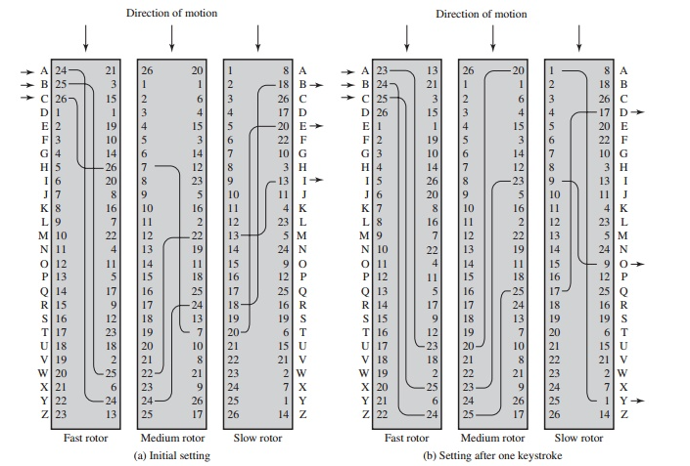

Slide 91
Steganography
Steganography is a method in which secret message is hidden in a cover media. Steganography means covered writing. Steganography is the idea to prevent secret information by creating the suspicion. Steganography is less popular than Cryptography. In steganography, structure of data is not usually altered.

Slide 92
Text
Audio
Video
Images
5. Network or Protocol

Slide 93
Steganography is a method of hiding secret data, by embedding it into an audio, video, image, or text file. It is one of the methods employed to protect secret or sensitive data from malicious attacks.
Cryptography and steganography are both methods used to hide or protect secret data. However, they differ in the respect that cryptography makes the data unreadable, or hides the meaning of the data, while steganography hides the existence of the data.

Slide 94
In layman’s terms, cryptography is similar to writing a letter in a secret language: people can read it, but won’t understand what it means. However, the existence of a (probably secret) message would be obvious to anyone who sees the letter, and if someone either knows or figures out your secret language, then your message can easily be read.
If you were to use steganography in the same situation, you would hide the letter inside a pair of socks that you would be gifting the intended recipient of the letter. To those who don’t know about the message, it would look like there was nothing more to your gift than the socks. But the intended recipient knows what to look for, and finds the message hidden in them.

Slide 95
Similarly, if two users exchanged media files over the internet, it would be more difficult to determine whether these files contain hidden messages than if they were communicating using cryptography.
Cryptography is often used to supplement the security offered by steganography. Cryptography algorithms are used to encrypt secret data before embedding it into cover files.
Image Steganography – As the name suggests, Image Steganography refers to the process of hiding data within an image file. The image selected for this purpose is called the cover image and the image obtained after steganography is called the stego image.
How is it done? An image is represented as an N*M (in case of greyscale images) or N*M*3 (in case of color images) matrix in memory, with each entry representing the intensity value of a pixel. In image steganography, a message is embedded into an image by altering the values of some pixels, which are chosen by an encryption algorithm. The recipient of the image must be aware of the same algorithm in order to know which pixels he or she must select to extract the message.

Slide 96
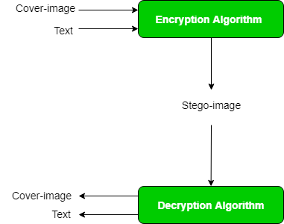

Slide 97
Detection of the message within the cover image is done by the process of steganalysis. This can be done through comparison with the cover image, histogram plotting, or noise detection. While efforts are being invested in developing new algorithms with a greater degree of immunity against such attacks, efforts are also being devoted towards improving existing algorithms for steganalysis, to detect the exchange of secret information between terrorists or criminal elements

